Slide 1


Predicting Postnatal Depression During the COVID-19 Pandemic: A Data Mining Approach
Presenter name
University of Colorado Boulder
DATA SCIENCE

Slide 2
Abstract
This project aims to develop a predictive model for identifying individuals at high risk of postnatal depression using data collected during the COVID-19 pandemic, highlighting the use of data mining techniques and the potential impact on healthcare interventions.
DATA SCIENCE

Slide 3
Sources of Data
The Pregnancy During the COVID-19 Pandemic (PdP) study was designed to investigate the associations between exposure to objective hardship caused by the pandemic and psychological distress in pregnant individuals, and developmental outcomes in their offspring.
More than 11,000 responses from social media beginning on April 5, 2020
The PdP study comprises a prospective longitudinal cohort of individuals who were pregnant at enrollment, with repeated follow-ups during pregnancy and the postpartum period. Participants were eligible if they were pregnant, ≥17 years old, at ≤35 weeks of gestation at study enrollment, living in Canada
DATA SCIENCE

Slide 4
Sources of Data 2
Maternal_Age
Household_Income
Maternal_Education
EPDS: Edinburgh Postnatal Depression Scale
PROMIS_Anxiety: Higher scores indicating greater severity of anxiety.
GAbirth: Gestational age at birth (in weeks)
Delivery_Date
Birth_Length
Birth_Weight
Delivery_Mode
NICU_stay
Threaten_Life: How much do (did) you think your life is (was) in danger during the pandemic? (0-100)
Threaten_Baby_Danger: How much do (did) you think your unborn baby's life is (was) in danger during the pandemic? (0-100)
Threaten_Baby_Harm: How much are you worried that exposure to the COVID-19 virus will harm your unborn baby? (0-100)
DATA SCIENCE

Slide 5
Introduction
The COVID-19 pandemic has heightened anxiety and stress among pregnant individuals, leading to increased mental health challenges due to social isolation and healthcare disruptions.
Early detection of postnatal depression is vital for the health of both mothers and infants. Timely intervention can prevent long-term psychological issues and improve overall outcomes.
Objectives:
Develop a predictive model for postnatal depression.
Identify key predictors from demographic, mental health, and perceived threat data.
Support healthcare interventions by providing actionable insights.
Enhance maternal and infant health through early detection and support.
DATA SCIENCE

Slide 6
Problem Statement
Increased Stress During Pregnancy Due to COVID-19:
The pandemic has significantly elevated stress levels in pregnant individuals, contributing to mental health challenges.
Goal of Predicting Postnatal Depression:
Develop a model to predict postnatal depression using the Edinburgh Postnatal Depression Scale (EPDS), incorporating pandemic-specific stress factors.
Importance of Early Identification:
Early identification of at-risk individuals is crucial for timely intervention, reducing the risk of long-term mental health issues for both mothers and infants.
DATA SCIENCE

Slide 7
Proposed Work
Data Cleaning: Handling missing values and converting categorical variables.
EDA: Visualizing data relationships and identifying correlations.
Feature Engineering: Selecting relevant features.
Modeling: Training and evaluating regression models.
Evaluation: Using MSE and R² metrics.
Feature Importance: Identifying key features using the Random Forest model.
DATA SCIENCE

Slide 8
Evaluation Plan
Metrics for assessing model performance: MSE and R².
Criteria for success: low MSE, high R², and actionable insights.
Importance of feature importance analysis for refining the model.
DATA SCIENCE

Slide 9
Timeline
Week 3: Data Cleaning and Preparation
Week 4: Exploratory Data Analysis and Feature Engineering
Week 5: Model Training and Initial Evaluation
Week 6: Model Refinement and Feature Importance Analysis
Week 7: Final Evaluation and Report Preparation
DATA SCIENCE

Slide 10
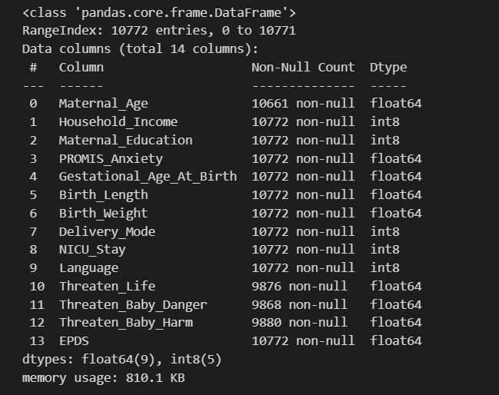
Process 1
Download data from OSF and save as CSV
Cleaned data
Replace NA values
Numerical
Categorical
Convert objects to floats
DATA SCIENCE

Slide 11
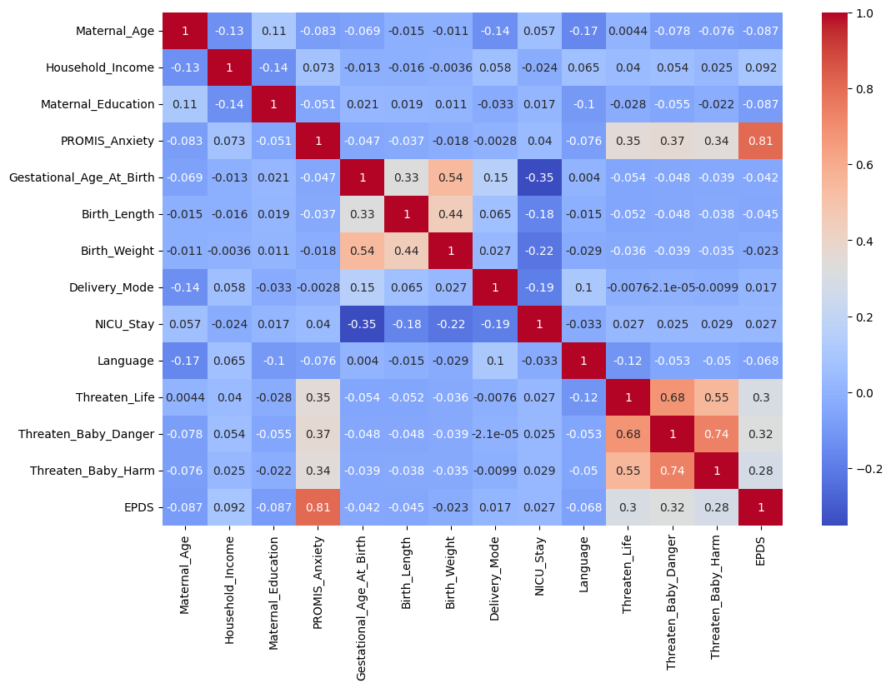
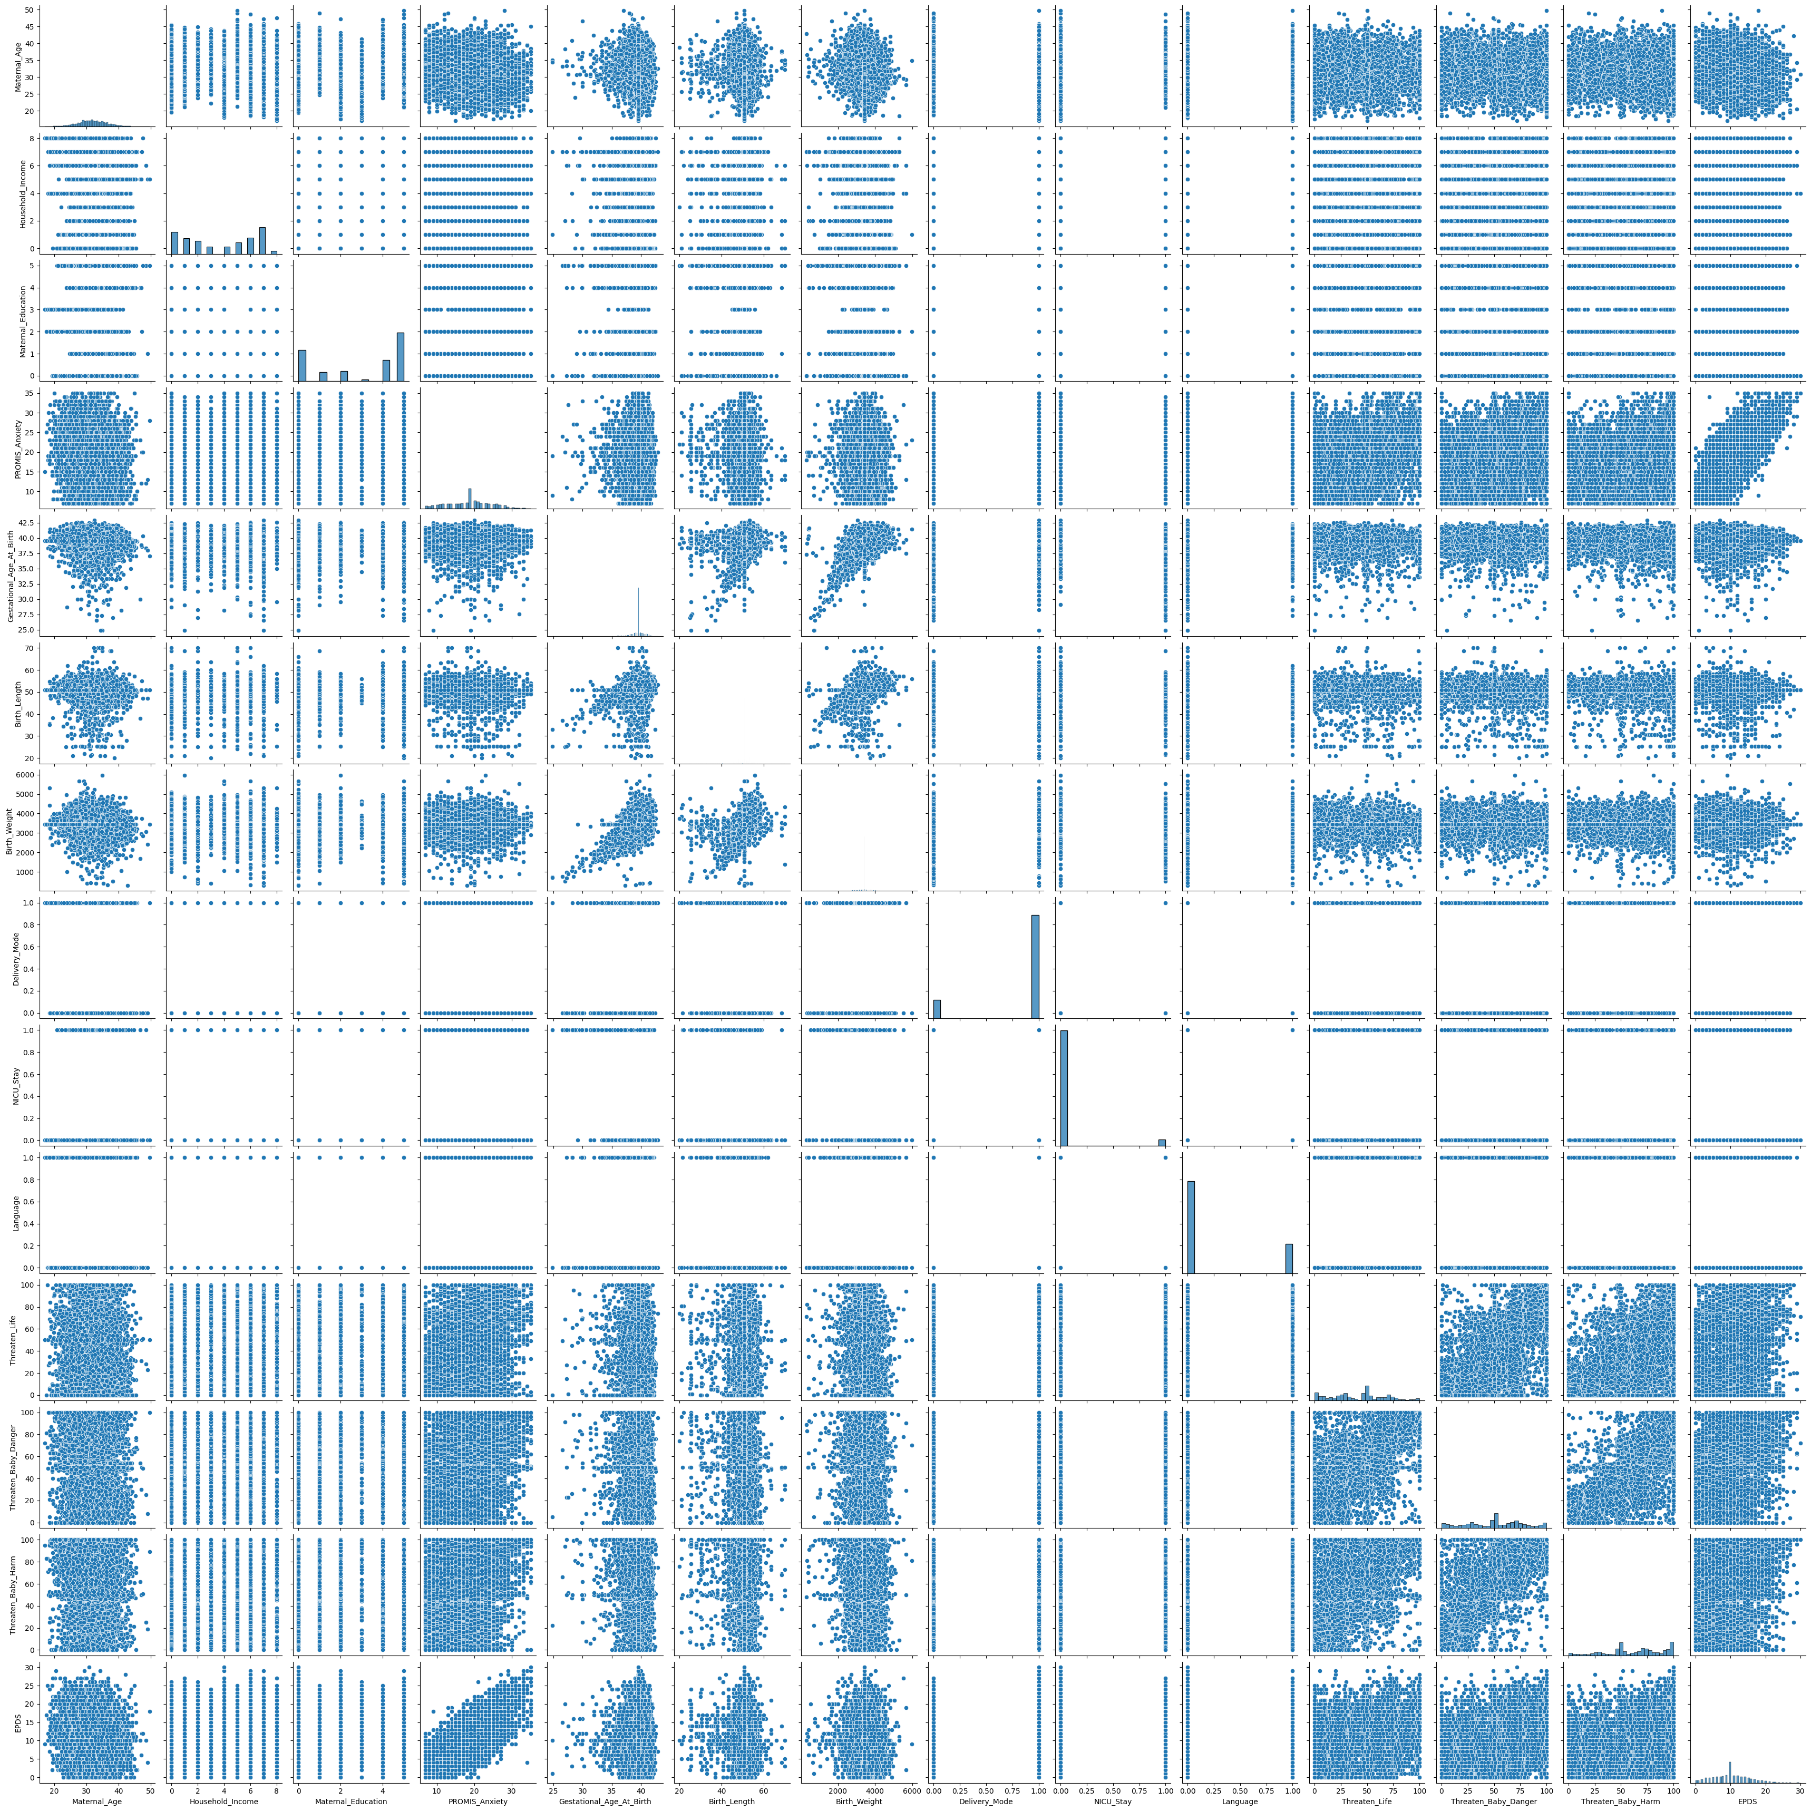
Process 2
Run pairplot and heatmap to identify relationships between columns
Identify key features to find relationships with EPDS
'Maternal_Age', 'Household_Income', 'Maternal_Education', 'PROMIS_Anxiety', 'Threaten_Life', 'Threaten_Baby_Danger', 'Threaten_Baby_Harm'
DATA SCIENCE

Slide 12
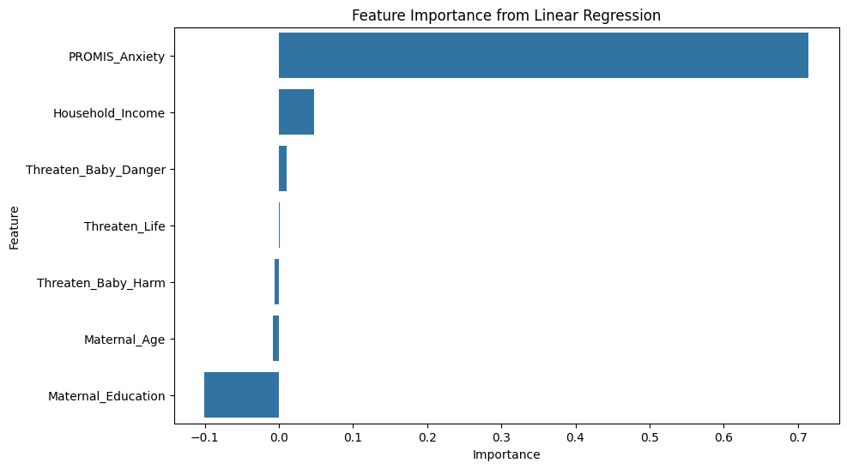
Process 3
Run linear regression using EPDS as response
MSE: 8.986360817947201, R2: 0.6620131234030475
Feature Importance
Maternal_Age -0.008575
Household_Income 0.047906
Maternal_Education -0.101161
PROMIS_Anxiety 0.714697
Threaten_Life 0.000784
Threaten_Baby_Danger 0.010607
Threaten_Baby_Harm -0.006049
DATA SCIENCE

Slide 13
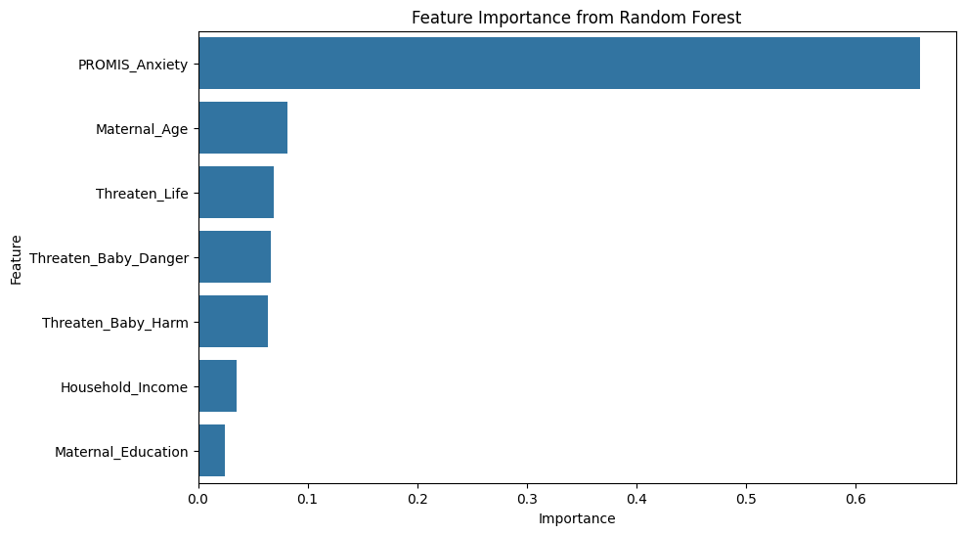
Process 4
Run Random Forest using EPDS as response
Random Forest Regressor - MSE: 9.45304111111111, R2: 0.64446076624187
Feature Importance
PROMIS_Anxiety 0.658800
Maternal_Age 0.081931
Threaten_Life 0.069322
Threaten_Baby_Danger 0.066066
Threaten_Baby_Harm 0.064104
Household_Income 0.034901
Maternal_Education 0.024877
DATA SCIENCE

Slide 14
Conclusion
The linear model performed better than the random forest
The key indicator of postnatal anxiety is prenatal anxiety
DATA SCIENCE

Slide 15
Future Work
Would love updated data on how the child is performing
More demographic data would be great to see if anything else can impact postpartum anxiety levels
Would love to compare to mothers before and after COVID
DATA SCIENCE

Slide 16
References
Gao, W., Jalal, Z., Taylor, B. K., Qian, H., Reichert, A. R., & Blank, P. R. (2023). The impact of COVID-19 pandemic on mental health in pregnant individuals. The Lancet Regional Health – Europe, 24. https://doi.org/10.1016/j.lanepe.2023.100473
Huang, Y., Alvernaz, S., Kim, S. J., Maki, P., Dai, Y., & Peñalver Bernabé, B. (2023). Predicting prenatal depression and assessing model bias using machine learning models. medRxiv. https://doi.org/10.1101/2023.07.17.23292587
DATA SCIENCE

